Slide 1


AISeQ
AISeQ

Slide 2
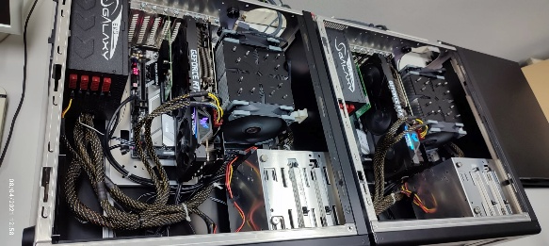
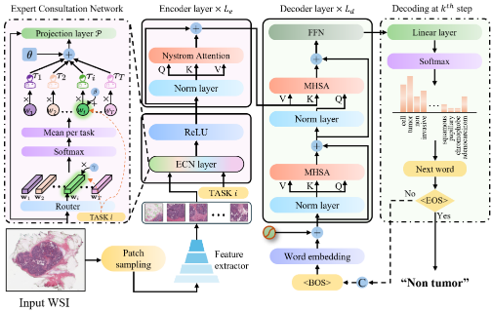


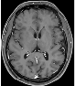

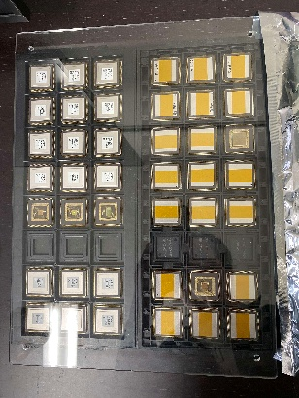
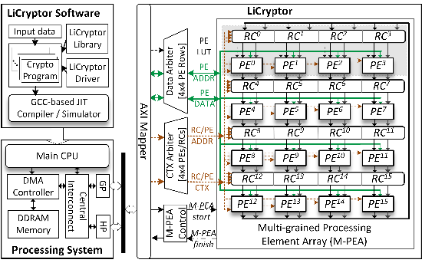
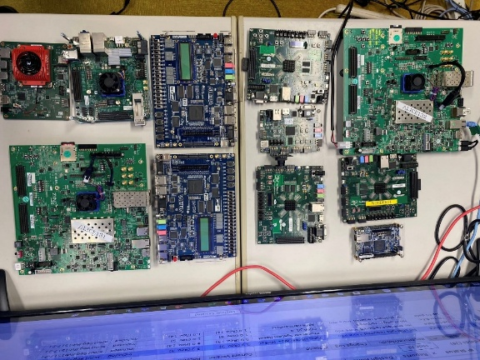
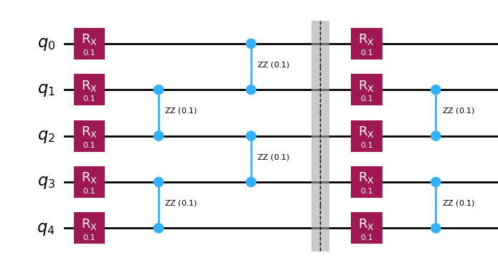
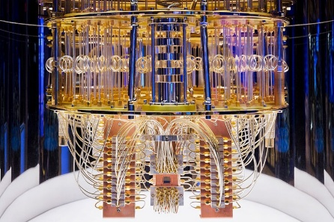
AI
Propose model
Training on GPU
Inference model
Semiconductor
RTL design
Simulating on FPGA
Fabricate chip
Quantum Computing
Deploy on real quantum computer
Quantum algorithms
Simulating on CPU/GPU/…

Slide 3

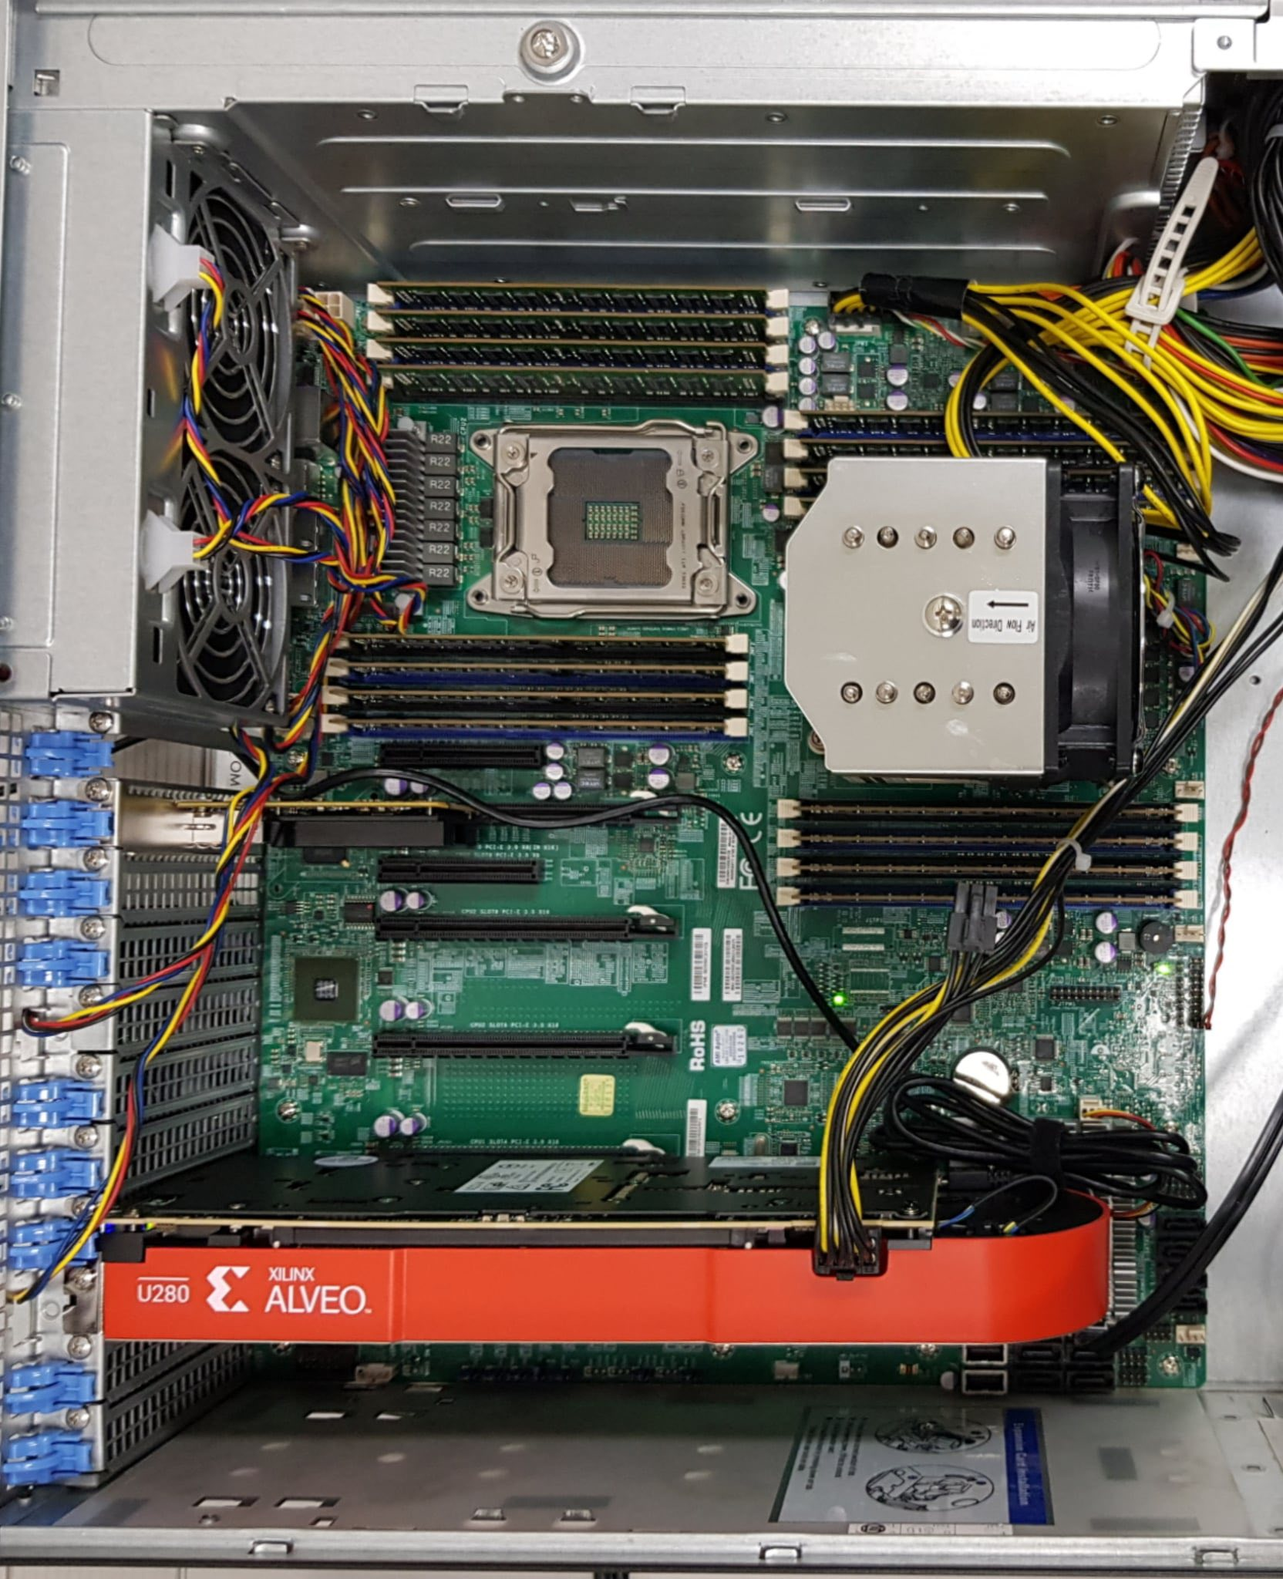
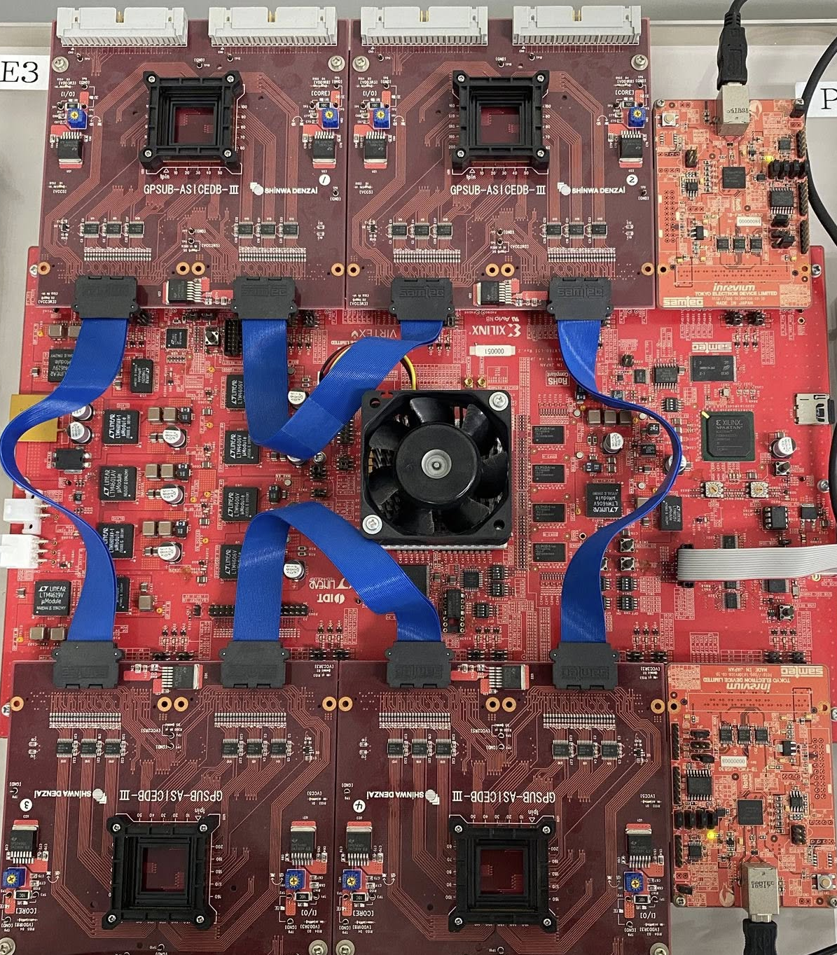
3 months
3 months
3 months
3 months
Basic knowledge*
Module 1**
Module 2**
Module 3**
Project*
High school student
Project 1,2
Thesis
End
Academy
Undergraduate student
Test
End
Test
MS/PhD student
End
Staff
R&D
Fabricate chip
Design
Simulation
Test
Partner
Mentor
Startup
Advisor
*Free, **Paid

Slide 4
AISeQ

Slide 5
AISeQ

Slide 6


GIVE AWAY THÁNG 9
NIKKE Noodle Stopper Brid

Slide 7


KẾT QUẢ GIVE AWAY
THÁNG 9 (BRID)
Số may mắn: 40
Đáp án đúng: B B

Slide 8
AISeQ
TUYỂN SINH VIÊN THAM GIA NGHIÊN CỨU (SOFTWARE)
Thời hạn: 11/10 – 20/10

Slide 9
AISeQ
SẮP ĐÓNG FORM ỨNG TUYỂN THAM GIA NGHIÊN CỨU (SOFTWARE)
Thời hạn: hết ngày 20/10

Slide 10







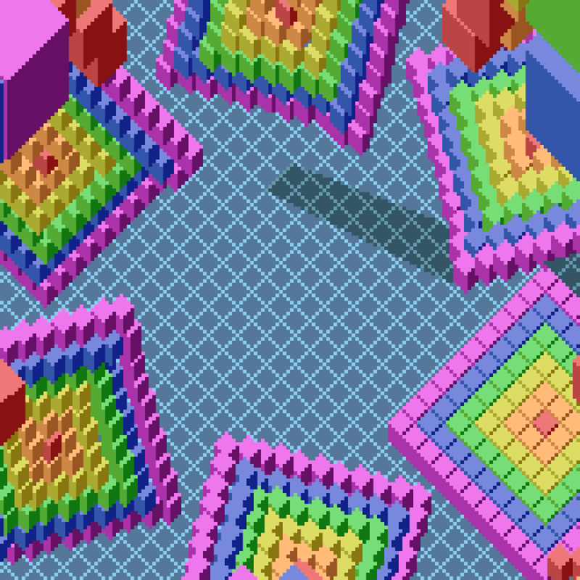


Vietnam National University – Ho Chi Minh city
UNIVERSITY OF INFORMATION TECHNOLOGY
Vietnam National University – Ho Chi Minh city
UNIVERSITY OF INFORMATION TECHNOLOGY
PhD. PHAM HOAI LUAN
Lecturer, Faculty of Computer Engineering
PhD. VU TUAN HAI
Lecturer, Faculty of Software Engineering
Email: luanph@uit.edu.vn
Phone: (+84) 383609042
Email: haivt@uit.edu.vn
Phone: (+84) 814822188
Quarter 34, Linh Trung ward, Ho Chi Minh city, Vietnam
Quarter 34, Linh Trung ward, Ho Chi Minh city, Vietnam
Nara Institute of Science and Technology
Graduate School of Science and Technology
Tohoku University
Frontier Research Institute
for Interdisciplinary Sciences
PhD. PHAM HOAI LUAN
Assistant. Prof, Information Science division
PhD. VU TUAN HAI
Visiting Researcher
Email: pham.luan@is.naist.jp
Phone: (+81) 8095315365
Email: tuan.hai.vu.b7@tohoku.ac.jp
Phone: (+81) 7089462244
Computing Architecture lab
Quantar lab
8916-5 Takayama, Ikoma, Nara 630-019, Japan
Aoba-6-3 Aramaki, Aoba Ward, Sendai, Miyagi 980-0845, Japan

Slide 11
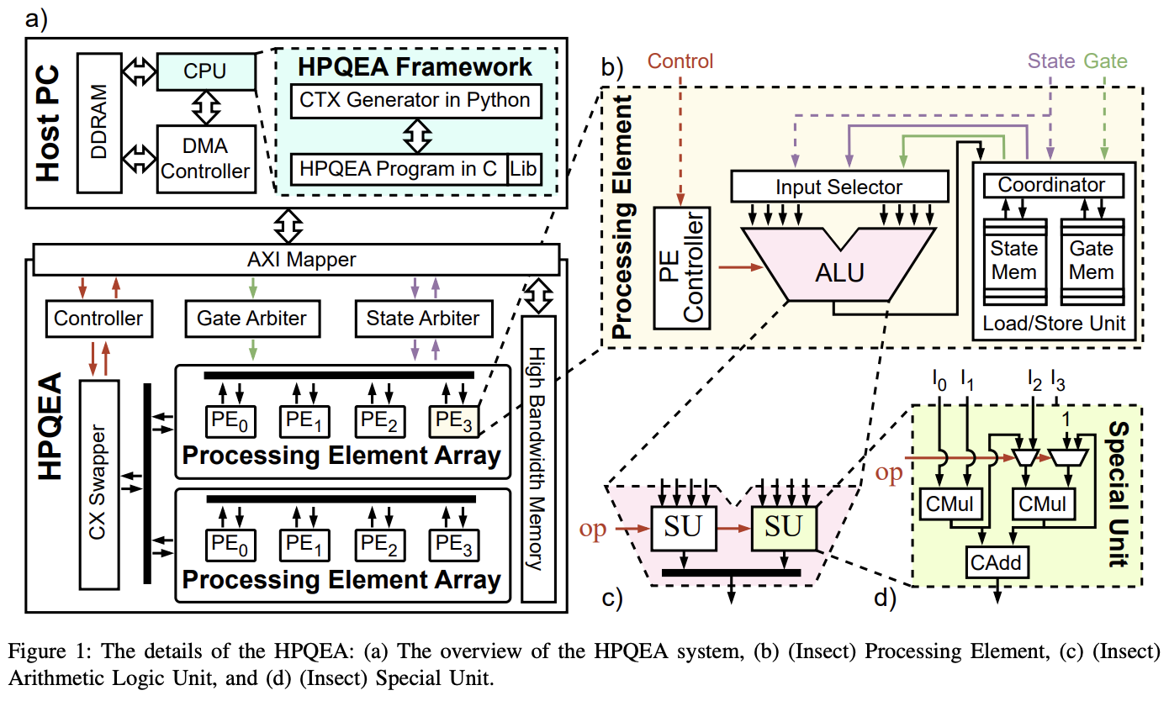
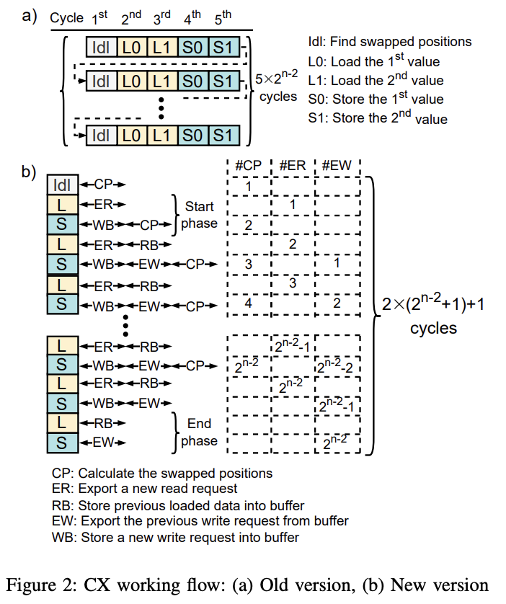
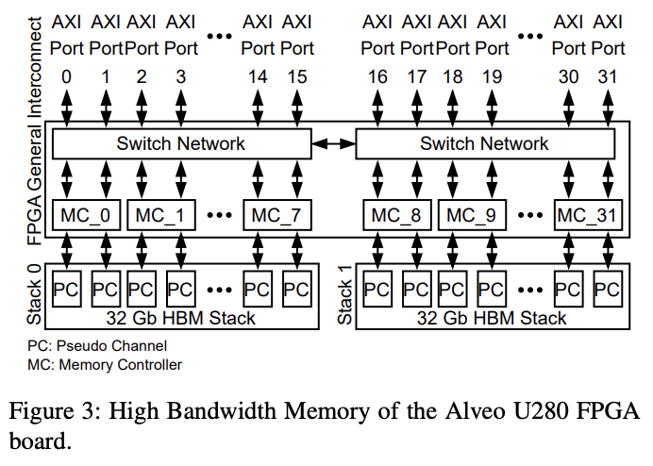

Slide 12
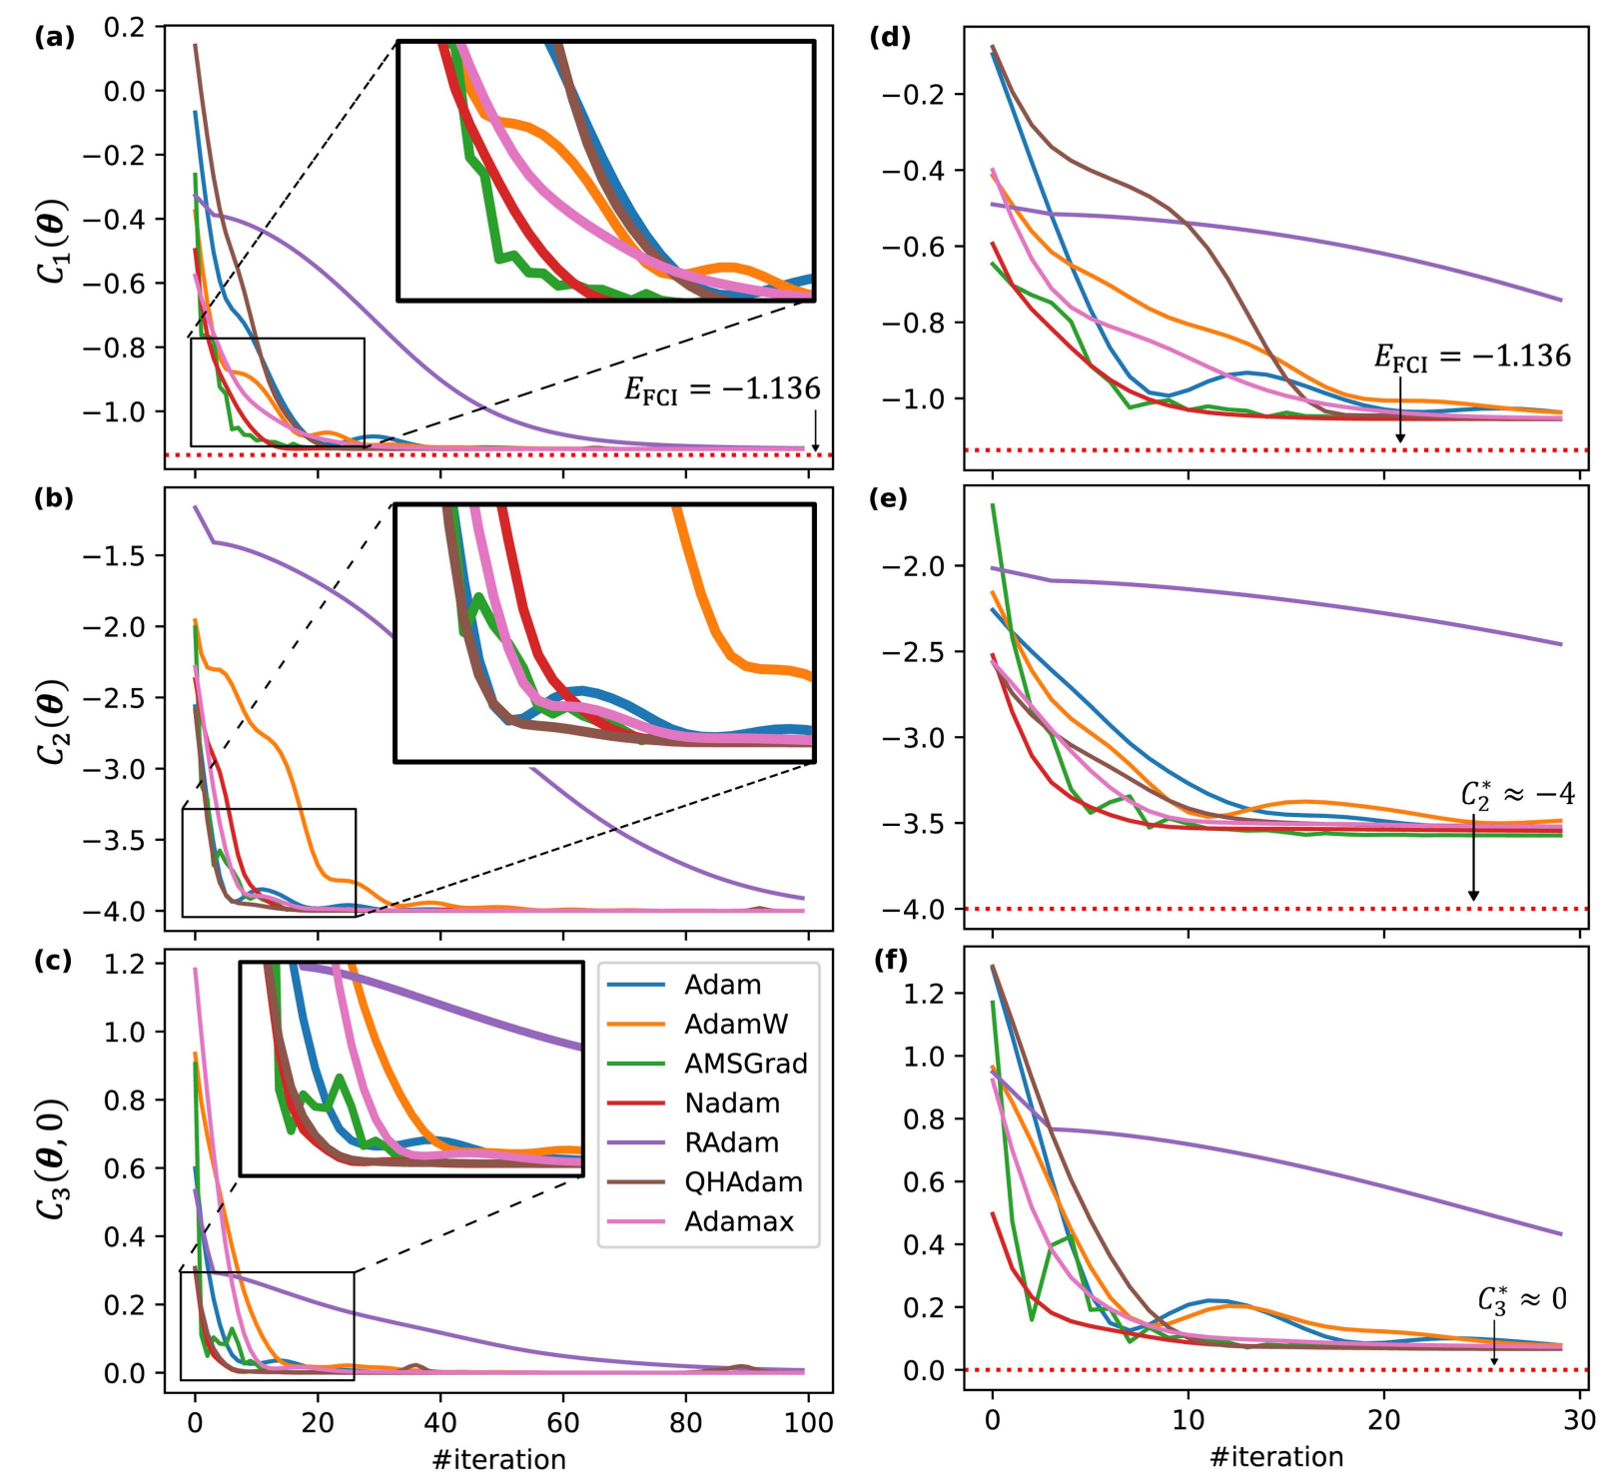
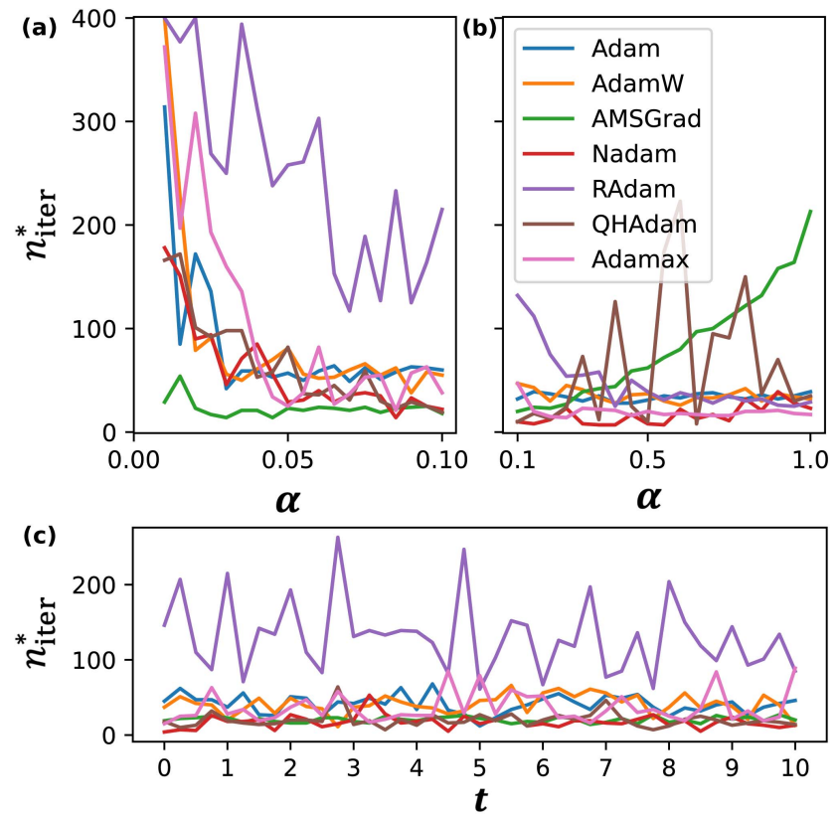
Cost curve under noiseless (left column) and noise condition (right column). (a/d) VQE, (b/e) QAOA, and (c/f) DS at fixed t = 1 under variant Adam optimizers.
The n∗ iter for convergence at various learning rates on (a) VQE and (b) QAOA. (c) At various times t on DS model.

